Slide 1
Test Automation Process

Slide 2
Agenda
Points when thinking about automation
How can Automation help?
How Long Do Automated Tests Survive?
Automation Test Planning
Best Practices in Test Automation

Slide 3
Points when thinking about Automation
So the first test automation question is this:
  If I automate this test, what manual tests will I lose?
  How many bugs might I lose with them?
  What will be their severity?

Slide 4
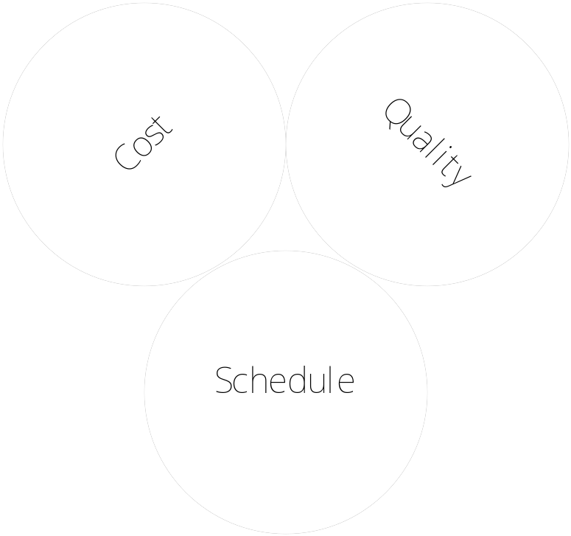
How can Automation help?
Cost
Quality
Schedule

Slide 5
How can Automation help? – Contd..
Through Intelligent Test Automation –
  Build code early, frequently
  Validate code early in the life cycle
  String them during integration, system test
  Validate across configuration (OS/DB)
Benefits -
  Improved quality at each phase
  Reduced rework effort
  Re-use minimize effort spent

Slide 6
How long do Automated tests survive
Automated tests produce their value after the code changes. Except for rare types of tests, rerunning a test before any code changes is a waste of time: it will find exactly the same bugs as before.
But a test will not last forever. At some point, the product will change in a way that breaks the test. The test will have to either be repaired or discarded.
To a reasonable approximation, repairing a test costs as much as throwing it away and writing it from scratch. Whichever you do when the test breaks, if it hasn’t repaid the automation effort by that point, you would have been better off leaving it as a manual test.

Slide 7
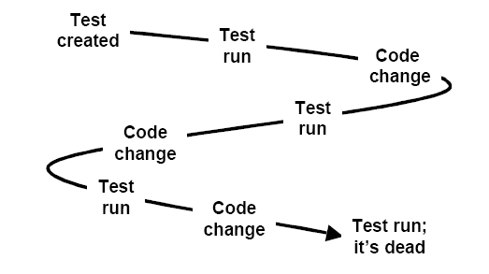
How long do Automated tests survive – contd..
In short, the test’s useful lifespan looks like this:

Slide 8
How long do Automated tests survive – contd..
When deciding whether to automate a test, you must estimate how many code changes it will survive. If the answer is "not many", the test had better be especially good at finding bugs.
To estimate a test’s life, you need some background knowledge. You need to understand something of the way code structure affects tests.

Slide 9
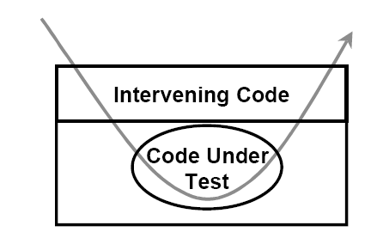
How long do Automated tests survive – contd..
Here’s a greatly simplified diagram to start with

Slide 10
Automated Test Planning
Test Plan document consists of following :
Define Automation Goals
Develop Automation Timeline based on due dates
Dedicate Application Test Environment and / or Test Lab
Verify Application State and Stability
Identify Automation Team Members
Identify Manual Test Procedures for Automation

Slide 11
Best practices in Automation
Create a core specialized team to provide test automation.
Build Framework – helps re-use, reduces automation dev effort.
Component based architecture could optimize cost (String them in system test).
Focus on ROI based Automation.
Develop iteratively.
Use open source tool where possible.

Slide 12
Automation Workflow
Prepare
Create
Verify & Enhance
Integrate
Test Environment
Record Actions
Enhance
Basic Test
Integrated
Test
Step for Test Automation Environment
Create Basic Test
Enhance the Automated
Run Multiple Test to verify flow of Data
1. Document Manual test step
2. Check Application Environment is stable
1. Record Actions
2. Confirm Successful Playback
3. Use Object Repository
1. Add Synchronization
2. Insert Checkpoint
3. Debug Test
4. Parameter’s Test
1. Pass Test Data
2. Calling External Files
3. Build Integrated Test sets

